Slide 1
Welcome to Curriculum Night
Ms. Andrea

Slide 2
About the Teacher
This is my 22nd year in education and my 17th year at HFE. This will begin my 5th year teaching the MI class @ HFE. I have previously taught Gen ED grades PreK-3 and KSE. I was born and raised in Connecticut. I received my undergraduate degree at The University of Rhode Island, and my graduate degree from Central Michigan University.

Slide 4
Communication
How I will communicate
Email- andreal@fultonschools.org
Microsoft Teams
Seesaw
Weebly - http://andreal2.weebly.com

Slide 5
Supplies
Students will need to bring their own set of supplies for F2F instruction
These should include:
8 or 16 pack of crayons
Pencils –Ticonderoga beginners (if possible)
Colored pencils (1 pack)
Glue sticks (2 or 4 pack)
Scissors
Device given by county & headphones – these will go back and forth from home to school during Phase 4

Slide 6
Class Schedule
Ms. Andrea’s Schedule
Ms. Andrea’s Schedule 2020-2021
7:10-7:40 Breakfast
7:45-8:15 – Daily 5 – students pick a book and read quietly until announcements (teachers will be working 1:1 with students on goal work)
8:15 – 9:00 - Morning Meeting/Calendar/math intro
9:00- Bathroom Break/Snack
9:15 – 10:15 Math
9:20-10:05 Tues. Thurs ADPE
10:00 Wash hands and Snack
10:15– 11:00 - Reading/ELA
11:00- 11:30 – Recess
11:45- 12:15 – Lunch
12:15 – Go Noodle/read aloud/movement
12:30 –1:30 – Reading/SS/Science (12:30-12:45 live for SS/SC/writing mini lesson
Specials Schedule
12:30 – 1:15 Adapted Art Thursdays
12:30 – 1:15 Adapted Music Mondays
11:35-12:20 3rd grade with Ms. Jones’ class (12:20-1:05 on Tues. for Spanish)
9:55-10:40 4th grade with Ms. Stockard’s class
10:45-11:30 5th grade with Ms. Hillard’s class

Slide 7
URL Attendance Policy
Grades K-1 – Participation: One of the following must be met each WEEK to mark a student’s daily attendance for the week: ​
Submission of weekly work packet or ​
Direct contact with parent/guardian that is logged or ​
Participation in a synchronous lesson ​
​
Grades 2-5 Participation: One of the following must be met each DAY for ELA or Math to mark student present for daily attendance: ​
Participation in a synchronous lesson or ​
Direct contact with parent/guardian/student that is logged or ​
Submission of an assignment ​
*If a student misses a day due to an excusable absence, the absence can be excused by sending an email detailing why they were absent.*

Slide 8
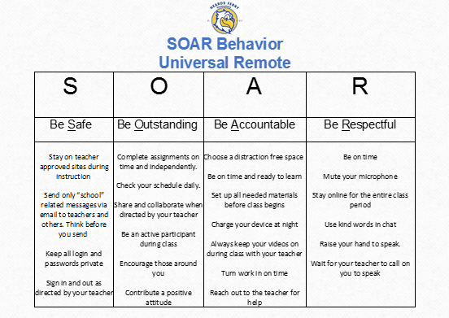
PBIS SOAR Behavior
SOAR Points
Eagle Points
Student of the Week
Virtual Pep Rally

Slide 9
Grade Reporting/Feedback
Report cards will go home twice a year (end of each semester).
Grades are cumulative BY SEMESTER.
The final semester grade will be derived from the average of all summative assignments.
A progress report will go home at the 1st and 3rd 9 weeks to report progress only.​
Students will receive feedback within 48 hours of work submission.
​

Slide 10
Grading Scale Grades 2-5
Grades 2-5​
​Letter grades (A, B, C, and F) and numeric grades will be used on report cards and transcripts for students in grades three through five. ​ ​
Grading Scale
A – 90 and above​
B – 80 – 89​
C – 70 -79​
F – 69 or below (or incompletes were not cleared by end of summer school 2021)​
I – Incomplete (Less than 80% of summative assignments were completed)​
NG – No grade (enrolled less than 20 days)​
Conduct ​
S
N
U

Slide 11
Math Inquiry Instruction
Georgia Standards of Excellence
Small Group Instruction (Based on Data)
Instructional Resources-
iReady Math
Unique Learning
Seesaw

Slide 12
Reading/ELA/Writing Inquiry
Georgia Standards of Excellence
Small Group Instruction (Based on Data)
One on one conferencing
Reading A-Z
iReady Reading
Unique Learning

Slide 13
International Baccalaureate
The PYP prepares students to become active, caring, lifelong learners who demonstrate respect for themselves and others and have the capacity to participate in the world around them. It focuses on the development of the whole child.

Slide 14
IB PYP International Baccalaureate Primary Years Programme
6 transdisciplinary themes
Learner Profile
IB Attitudes
Spanish for 1st –5th
Cookies for Character
International Inquirer
Service Projects

Slide 15
Digital Platforms
Seesaw
Reading A-Z
Starfall
Iready
Brainpop

Slide 16
Digital Citizens
Heards Ferry’s vision is to empower ALL students to behave safely and participate responsibly with technology.
Students will use their device for educational purposes only and be sure to be safe and appropriate while online.
They will listen to their head and heart and protect private information and respect themselves and others while online.
Lastly, they will stand up and say NO to cyberbullying!

Slide 17
Friendly Reminders
Tennis shoes/sneakers should be worn on PE days
Library books should be returned every other week (day TBD)
Blue folders returned daily
Devices should come to school fully charged

Slide 18
Questions, Comments, Concerns?
School phone: 470-254-6190
E-mail:
andreal@fultonschools.org

